Slide 1
Scaling to the Enterprise

Slide 2
What is Scaling Scrum?
Scrum is typically used by a single team working on a single product. Sometimes more than one team working on the same product but distinct areas of that product. Scrum works well in this situation especially with few dependencies between teams.
There are many situations that require many teams working on the same product (think about Microsoft Office) and there are many dependencies between teams, risks that affect many teams, and or need to have a coordinated delivery
These products can still use Scrum or other Agile methods however they might need to be scaled

Slide 3
What is Scaling Scrum?
There are a number of scaling frameworks but all share some common patterns: Scrum at team level, many teams sharing a backlog, planning is done collaboratively across teams, and the teams that use pull and self-organization
The various frameworks offer different levels of guidance from very little to very prescriptive.

Slide 4
Scaling Methods
Scrum of Scrums
LeSS
Scrum.org Nexus
Disciplined Agile Delivery
SAFe

Slide 5
Scrum of Scrums
This is the least perscriptive and closest to Scrum as described in the Scrum Guide
You can use Scrum of Scrums to collaborate between different Scrum teams working on the same product with few dependencies, few shared risks, and a single delivery
Scrum of Scrums has multiple Scrum teams work as they usually do with Scrum but have an extra meeting called Scrum of Scrums which is usually attended only by the Scrum Masters
The Scrum of Scrums meeting may happen as often as every day, every couple of days, or once a week depending on the amount of collaboration required between teams

Slide 6
Scrum of Scrums Meeting
The purpose of the Scrum of Scrums meeting is for the Scrum Master to bring their team’s road blocks to the other teams especially if the road block depends on another team
The Scrum Masters will collaborate and work with their teams to help clear any dependent road blocks for other teams
This works well for a small number of teams work on a relatively small and/or not very complex product
If there are a large number of dependencies and risks involving many teams this approach may not work
Video: https://www.youtube.com/watch?v=JAkbXzluBR4
Length 2:55

Slide 7
LeSS
LeSS is Large Scale Scrum
A scaling framework that is based on work in the financial and telecommunications industries
LeSS is defined by minimalism and minimal process (use as little process as possible to get multiple Scrum teams to work well).
LeSS consists of a handful of rules and there are also guides and examples for how to customize these rules as the organization grows
The idea is to manage the complexity of large-scale development by simplifying it as much as possible.

Slide 8
LeSS
LeSS recommends that multiple teams (up to 8) have the same Product Owner and a shared Product Backlog
Since the Product Owner is the Product Owner for up to 8 teams LeSS precludes the Product Owner from participating at a detail level and gives more teams more responsibility to work out their own solutions.
The teams have their sprints synchronized to the Product Level Sprint leading to one integrated Potentially Shippable Product increment
Sprint Planning, Sprint Review, and Sprint Retrospective runs at the same time for all teams.

Slide 9
LeSS
Sprint Planning is split into two parts. LeSS recommends the first part is a joint meeting attended by representatives from all of the teams to agree what product backlog items will be built in the coming sprint. The second part of Sprint Planning is then used by each team to product the Sprint Backlog and agree how the product backlog items will be built.
The end of the sprint is also synchronized. There is one common Sprint Review for all the teams. The retrospective is divided into two parts similar to sprint planning. First each team holds their own individual team Retrospective then representatives from each team hold a joint Retrospective together that enables them to identify and address issues that can not be solved at the individual team level

Slide 10
Resources
Introduction to LeSS
https://www.youtube.com/watch?v=1BZf_Oa7W94
(length 8:14) – only first half (about 4:00)

Slide 11
Nexus
Ken Schwaber (co-creator of Scrum) along with Scrum.org developed Nexus, it is a framework that implements Scrum at scale across multiple teams to deliver a single integrated product. Teams work in a common development environment and are focuses on producing a combined increment every sprint with minimal dependencies
Nexus can be applied to 3-9 Scrum teams each consisting of 3 to 9 developers. Nexus is not recommended for more than 9 teams and 80 practitioners
Nexus is a framework that is built upon Scrum but does not change the foundation of Scrum

Slide 12
Nexus
The Nexus Framework adds a new role, the Nexus Integration Team and new events: a Nexus Daily Scrum, a Nexus Spring Planning, Nexus Sprint Backlog, and Nexus Sprint Retrospective and Refinement
There are no product owners in each team. There is only one Product Backlog and one Product Owner to minimize complexity and ensure prioritization is done properly
Each team still has a Scrum Master but not necessarily full time, the same person could be the Scrum Master for multiple teams

Slide 13
Nexus
Nexus Integration Team, exists to coordinate, coach, and supervise the application of Nexus and the operation of Scrum so the best outcomes are derived.
The Nexus Integration Team consists of the Product Owner, a Scrum Master, and Nexus Integration Team Members

Slide 14
Nexus
Nexus Sprint Planning – representatives from each Scrum Team meet to discuss and review the refined Product Backlog. They select Product Backlog items for each team. Each Scrum Team then plans its own Sprint, interactive with other teams as appropriate.
The outcome is a set of Sprint Goals that align with the overarching Nexus Sprint Goal, each Scrum Team’s Sprint Backlog, and a single Nexus Sprint Backlog. The Nexus Sprint Backlog makes the work of all Scrum Team’s selected product backlog items and any dependencies transparent.

Slide 15
Nexus
Nexus Daily Scrum – representatives from each Development Team meet daily to identify if any integration issues exist.
If any integration issues are identified this information is transferred back to each Scrum Team’s Daily Scrum.
Scrum Teams then use their Daily Scrum to create a plan for the day, being sure to address the integration issues raised during the Nexus Daily Scrum

Slide 16
Nexus
Nexus Sprint Review – held at the end of the Sprint to provide feedback on the Integrated Increment that a Nexus has built over the Sprint.
All individual Scrum Teams meet with stakeholders to review the Integrated Increment.
Adjustments may be made to the Product Backlog

Slide 17
Nexus
Nexus Sprint Retrospective – representatives from each Scrum Team meet to identify shared challenges.
Each Scrum Team then holds individual Sprint Retrospectives.
Representatives from each team meet again to discuss any actions needed based on shared challenges to provide bottom-up intelligence

Slide 18
Resources
Introduction to the Nexus Scaled Scrum Framework
https://www.youtube.com/watch?v=29M-rw6DWd8
(length: 7:41)

Slide 19
Disciplined Agile Delivery (DAD)
Disciplined Agile Delivery is part of the Disciplined Agile (DA) toolkit
Recently incorporated into the Project Management Institute
DAD is a people-first learning-oriented hybrid agile approach to solution delivery
DAD has a risk-value delivery lifecycle, is goal-driven, is enterprise aware, and is scalable
DAD is a hybrid approach which extends Scrum with other proven strategies like Agile Modeling (AM), Extreme Programming (XP), United Process (UP), Kanban, Lean Software Development, SAFe, LeSS, and several other methods

Slide 20
Disciplined Agile Delivery (DAD)
DAD extends the construction-focused lifecycle of Scrum to address the full, end-to-end delivery lifecycle from project initiation all the way to delivering the solution to end users.
DAD does not prescribe a single lifecycle
DAD provides choices not prescriptions and is a goal driven approach

Slide 21
Disciplined Agile Delivery (DAD)
Roles of DAD
  Primary roles: team lead, team member, product owner, architecture owner, stake holder
  Supporting roles: specialist, independent tester, domain expert, technical expert, integrator

Slide 22
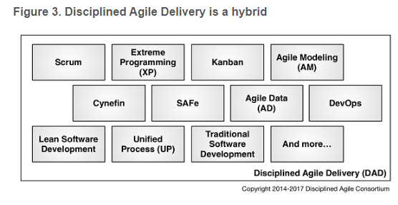
Disciplined Agile Delivery (DAD)
Hybrid- DAD builds upon the solid foundation of other methods and software process frameworks. DAD adopts practices and strategies from existing sources and provides advice for when and how to apply them together.

Slide 23
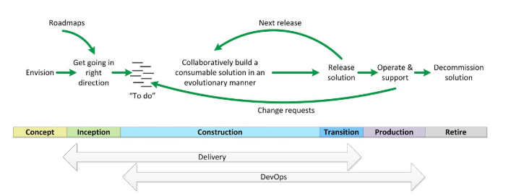
Disciplined Agile Delivery (DAD)
Delivery – the focus of DAD is on delivery and focuses on the full lifecycle. There are six lifecycles that are supported and start from project initiation and go until delivery.

Slide 24
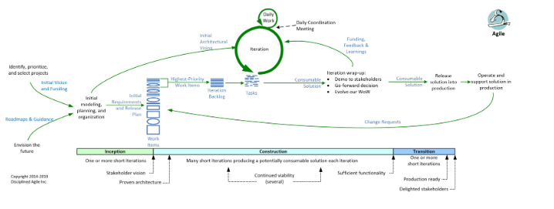
Disciplined Agile Delivery (DAD)
Agile life cycle

Slide 25
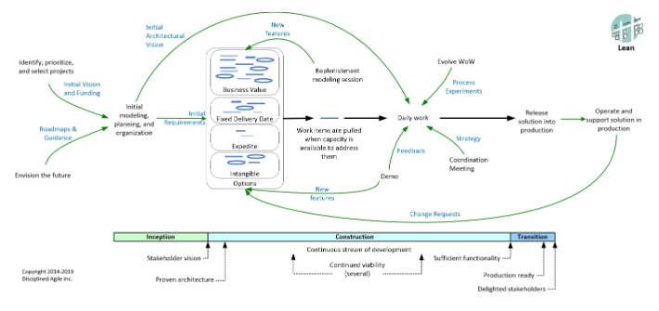
Disciplined Agile Delivery (DAD)
Lean life cycle

Slide 26
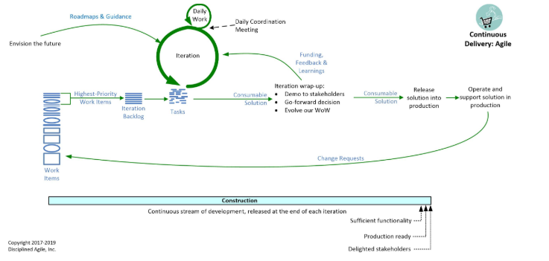
Disciplined Agile Delivery (DAD)
Agile Continuous Delivery life cycle

Slide 27
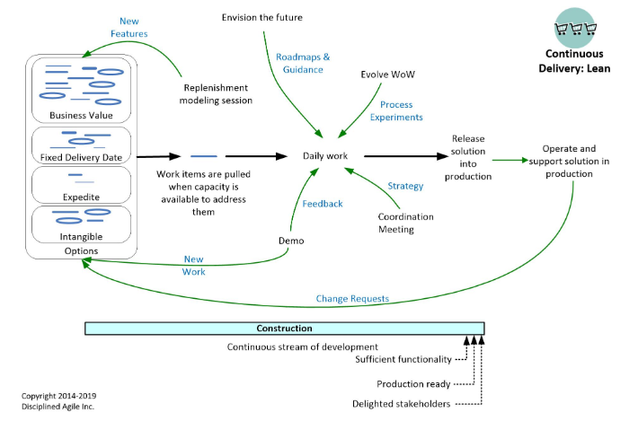
Disciplined Agile Delivery (DAD)
Lean Continuous Delivery life cycle

Slide 28
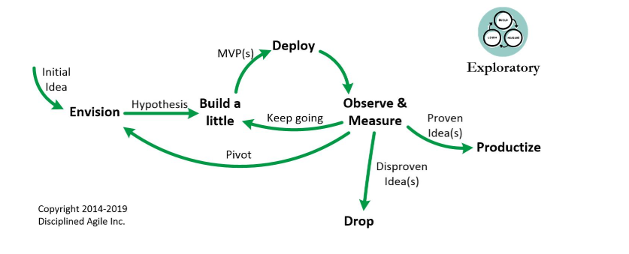
Disciplined Agile Delivery (DAD)
Exploratory (Lean Startup) life cycle

Slide 29
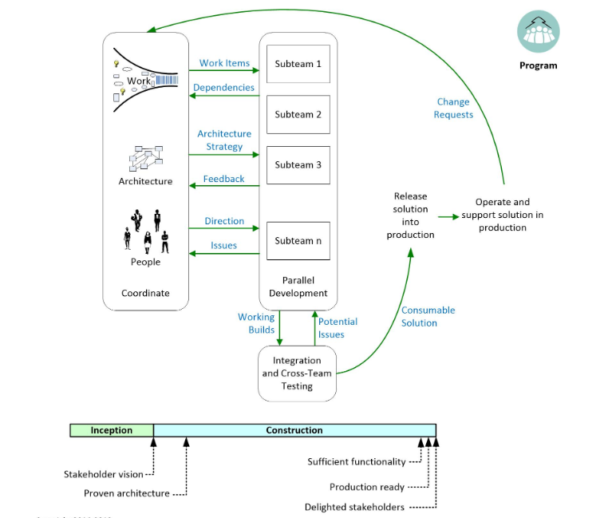
Disciplined Agile Delivery (DAD)
Program life cycle

Slide 30
Resources
Disciplined Agile Delivery: A Brief Introduction
https://www.youtube.com/watch?v=_J6OYgxH3vo
(length 26:10)
Disciplined Agile Overview
https://www.youtube.com/watch?v=dHNnYtCj5oc
(length 27:07)

Slide 31
SAFe
SAFe (Scaled Agile Framework) is an interactive software framework that enables you to apply Lean, Agile, and Scrum practices at large enterprises
SAFe is described as an interactive knowledge base for implementing agile practices at an enterprise scale and it provides a lot of guidance and covers a broad scope including financing and enterprise architecture.
https://www.scaledagileframework.com/

Slide 32
SAFe
There are 7 core competencies
  Lean-agile leadership
  Organizational agility
  Lean portfolio management
  Enterprise solution delivery
  Agile product delivery
  Team and technical agility
  Continuous learning culture
There are 4 levels to SAFe configuration
  Essential SAFe
  Large solution SAFe
  Portfolio SAFe
  Full SAFe
https://www.scaledagileframework.com/

Slide 33
Essential SAFe
Contains the minimal set of roles, events, and artifacts required to continuously deliver business solutions via an Agile Release Train (ART) as a team of agile teams
The Agile Release Train is the heart of Essential SAFe and is a virtual organization formed to span functional boundaries, eliminate unnecessary handoffs and steps, and accelerate value delivery by implementing lean-agile principles and practices
https://www.scaledagileframework.com/

Slide 34
Essential SAFe
Three core competencies:
  Team and technical agility – the critical skills and lean-agile principles and practices that high-performing agile teams and teams of agile teams use to create high-quality solutions for the their customers
  Agile product delivery – customer-centric approach to defining, building, and releasing a continuous flow of valuable products and services to customers and users
  Lean-agile leadership – how lean-agile leaders drive and sustain organizational change and operational excellence
There are many roles, artifacts, events, and concepts within the Essential SAFe level
https://www.scaledagileframework.com/

Slide 35
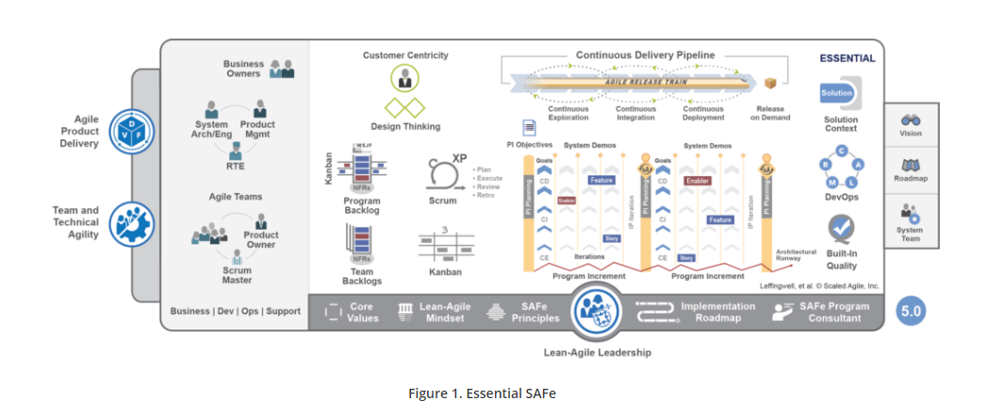
Essential SAFe
https://www.scaledagileframework.com/

Slide 36
Large Solution SAFe
Describes additional roles, practices, and guidance to build and evolve systems
Includes the Essential SAFe configuration
Adds the Enterprise Solution Delivery competency that describes how to apply lean-agile principles and practices to the specification, development, deployment, operation, and evolution of systems
There are new roles, events, and artifacts for the Large Solution level
https://www.scaledagileframework.com/

Slide 37
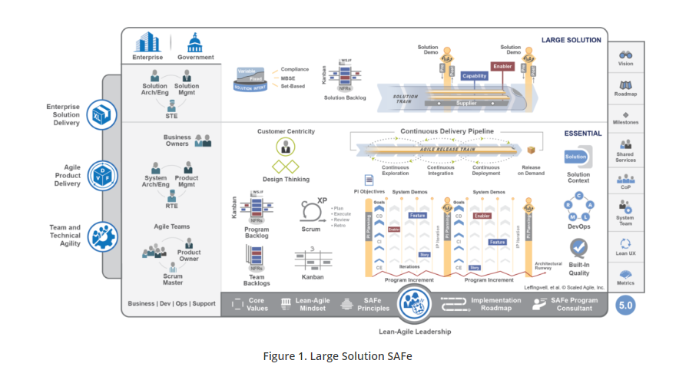
Large Solution SAFe
https://www.scaledagileframework.com/

Slide 38
Portfolio SAFe
Aligns strategy with execution and organizes solution development around the flow of value through one or more value streams
Includes the Essential SAFe configuration
Has additional roles, events, and artifacts
https://www.scaledagileframework.com/

Slide 39
Portfolio SAFe
Three additional core competencies:
  Lean Portfolio Management – aligns strategy and execution by applying lean and systems thinking approaches to strategy and investment funding, agile portfolio operations, and governance
  Continuous Leaning Culture – describes a set of values and practices that encourage individuals, and the enterprise as a whole, to continually increase knowledge, competence, performance, and innovation
  Organizational Agility – describes how lean-thinking people and agile teams optimize their business processes, evolve strategy with clear and decisive commitments, and quickly adapt the organization as needed
https://www.scaledagileframework.com/

Slide 40
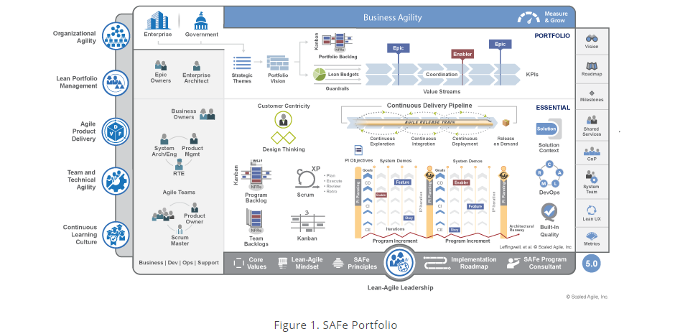
Portfolio SAFe
https://www.scaledagileframework.com/

Slide 41
Full SAFe
Full SAFe includes the Essential, Large Solution, and Essential configurations
https://www.scaledagileframework.com/

Slide 42
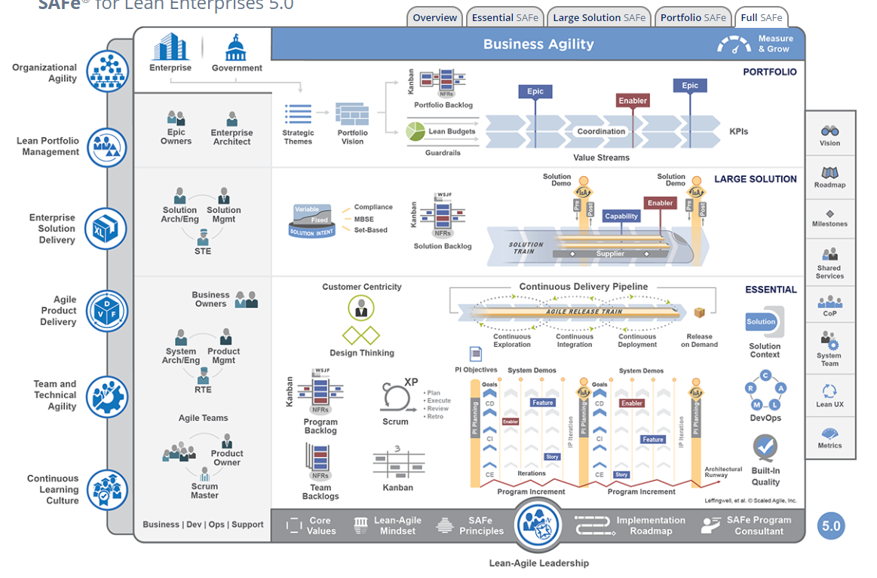
Full SAFe
https://www.scaledagileframework.com/

Slide 43
Resources
SAFe 5.0 overview in 5 minutes
https://www.youtube.com/watch?v=aW2m-BtCJyE

Slide 44
Additional Resources
What is Scaled Scrum?
https://www.youtube.com/watch?v=rrFVBAnX7xQ
Length 6:43

